Slide 1
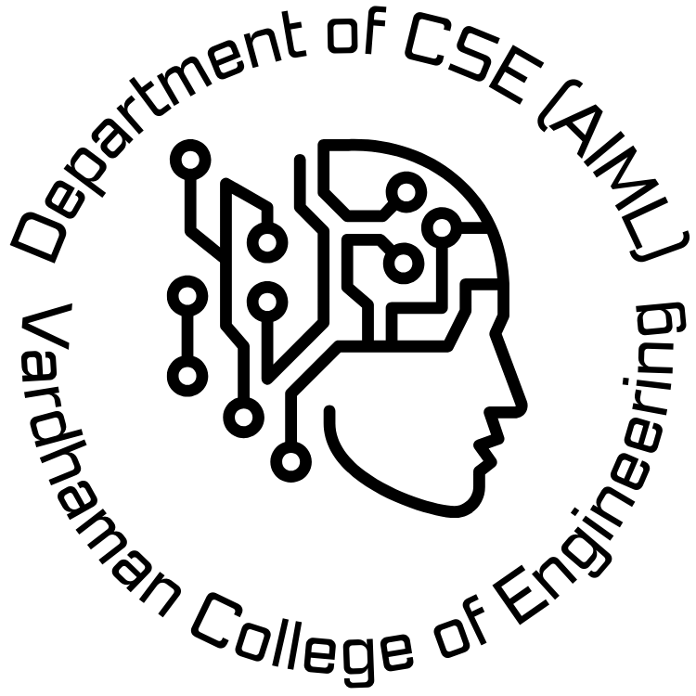

VARDHAMAN COLLEGE OF ENGINEERING, HYDERABAD Autonomous institute affiliated to JNTUH DEPARTMENT OF CSE(AI&ML)
Title:SMART AGRICULTURE MONITORING SYSTEM USING IOT
BATCH ID : 31
S. No | Roll. No | Student Name
1 | 21881A6678 | DEVARSHETTY MANISH KUMAR
2 | 21881A66A0 | LONKA MAHAJAN
3 | 21881A66A9 | SUMANTH
4
Supervisor
MAJJARI SUDHAKAR
Department of CSE-(AI&ML)

Slide 2
Outlines
Abstract
Introduction
Literature Review
Existing System with Pros and Cons (comparision with existing systems- Table)
Proposed method
References
DEPARTMENT OF _____ PROJECT WORK PHASE-1 REVIEW-1

Slide 3
Abstract
This iot-based agriculture monitoring system employs wireless sensor networks strategically placed at various nodes to collect data from different sensors.
The collected information is transmitted through a wireless protocol. the core of this smart agriculture system is powered by arduino and includes sensors for temperature, moisture, and water levels, a dc motor, and a gprs module.
Upon initiation, the system assesses water levels, humidity, and moisture, promptly sending sms alerts to mobile phones regarding the observed levels.
The sensors continuously monitor water levels, activating the water pump if a decline is detected.
In the case of elevated temperatures, the system initiates and regulate the environment.
All relevant information is displayed on an lcd module. the iot platform visualizes this data, presenting real-time insights into humidity, moisture, and water levels with corresponding timestamps, updated every minute.
A farmer is notified regarding the extracted data from the sensors .
The farmer can control the motor on and off system through a virtual button and a physical button is provided in the model.
The collected data from the sensors are used for machine learning models to predict the suitable crop according to the data extracted from the sensors .

Slide 4
Introduction
The evolution of Smart Agriculture Monitoring Systems using the Internet of Things (IoT) has significantly transformed traditional farming practices. This literature survey explores the various aspects and advancements in this field.
IoT in Agriculture:
Investigating the integration of IoT in agriculture, highlighting its role in collecting real-time data from diverse sources such as sensors, drones, and weather stations.
Sensor Technologies:
Analyzing the types of sensors employed in smart agriculture, including soil moisture sensors, temperature sensors, and humidity sensors, to monitor and optimize crop conditions.
Communication Protocols:
Reviewing communication protocols like MQTT and CoAP that facilitate seamless data exchange among devices in the agriculture ecosystem, ensuring efficient monitoring and control.
Data Analytics and Decision Support:
Examining the utilization of data analytics techniques to process the vast amounts of data generated by IoT devices, providing farmers with actionable insights for better decisionmaking.

Slide 5
Existing System

Slide 6
Pros and Cons of Existing System

Slide 7
Problem Statement
Traditional agricultural practices lack the precision and data-driven approach needed to optimize resource utilization, maximize yields, and minimize environmental impact.
This results in:
Decreased Crop Yields: Suboptimal conditions and delayed responses to crop issues lead to reduced production.
Resource Waste: Inefficient water and fertilizer application leads to excess consumption and environmental harm.
Increased Environmental Impact: Water pollution, soil degradation, and greenhouse gas emissions from agricultural practices negatively impact the environment.
Labor Dependence: Manual monitoring is time-consuming, prone to human error, and limits scalability.

Slide 8
Objectives-Proposed System
A smart agriculture monitoring system using IoT aims to address the inefficiencies and data-driven aspects of traditional agricultural practices. Here are some key objectives:
1. Enhance Crop Yield and Quality:
Optimize resource utilization: Precise data on soil moisture, temperature, and nutrient levels enables targeted irrigation, fertilization, and pest control, leading to improved crop growth and yield.
Early detection and prevention of crop issues: Real-time monitoring allows for early identification of diseases, pests, and environmental stresses, enabling prompt intervention and minimizing yield losses.
Improved crop quality: Controlled environmental conditions and precise resource application contribute to better crop quality, size, and taste.
2. Reduce Resource Waste and Environmental Impact:
Minimize water usage: Precise irrigation based on real-time soil moisture data optimizes water consumption, reducing waste and promoting water conservation.
Efficient fertilizer application: Targeted fertilization based on soil nutrient levels prevents over-application, minimizing environmental pollution and soil degradation.
Reduced reliance on chemical pesticides: Real-time pest monitoring and targeted interventions can lessen the need for chemical pesticides, promoting organic farming practices and protecting biodiversity.

Slide 9
References

Slide 10


